Slide 1
GitHub e Readme
SERVIÇO NACIONAL DE APRENDIZAGEM COMERCIAL
CURSO DE PROGRAMADOR DE SISTEMAS
Prof. MSc. Wei Lin
RIO DO SUL, JULHO/2021

Slide 2

Cadastro:
Link: https://github.com/

Slide 3
Cadastro:
Link: https://github.com/

Slide 4
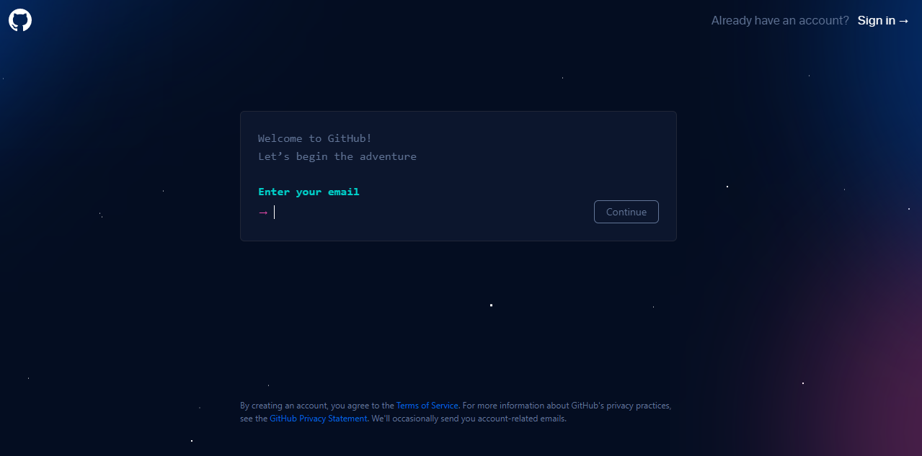
Cadastro:
Link: https://github.com/

Slide 5
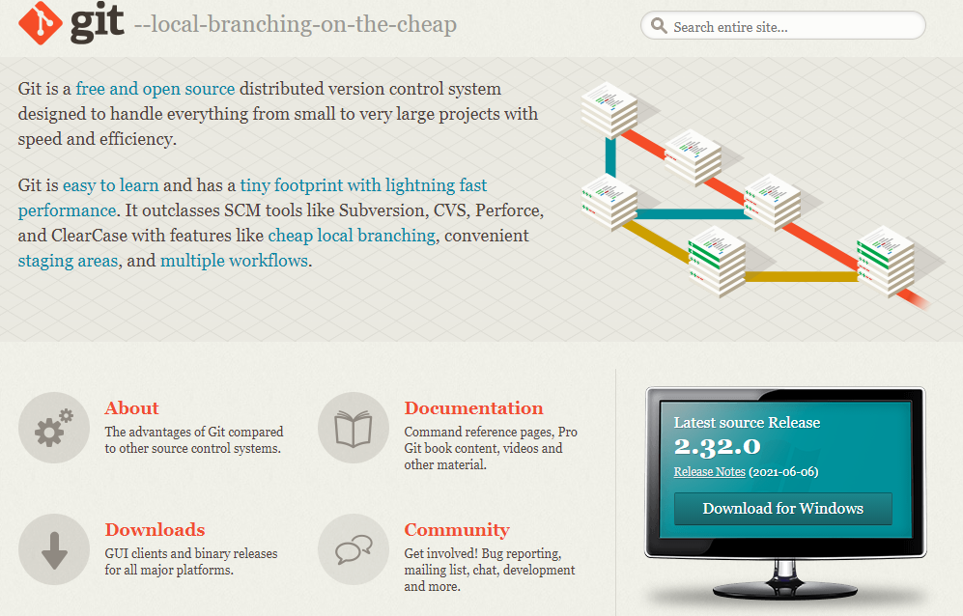
Instalação de Git:
Link: https://git-scm.com/

Slide 6
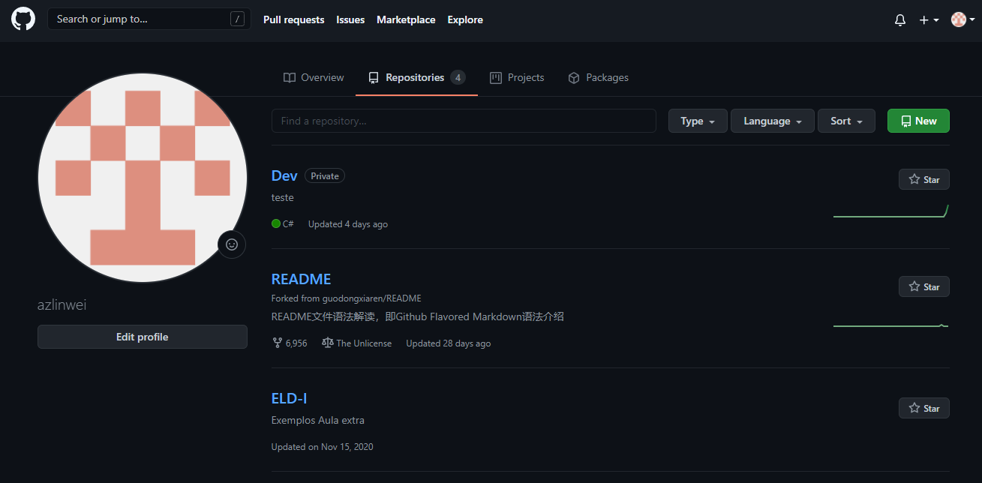

Slide 7
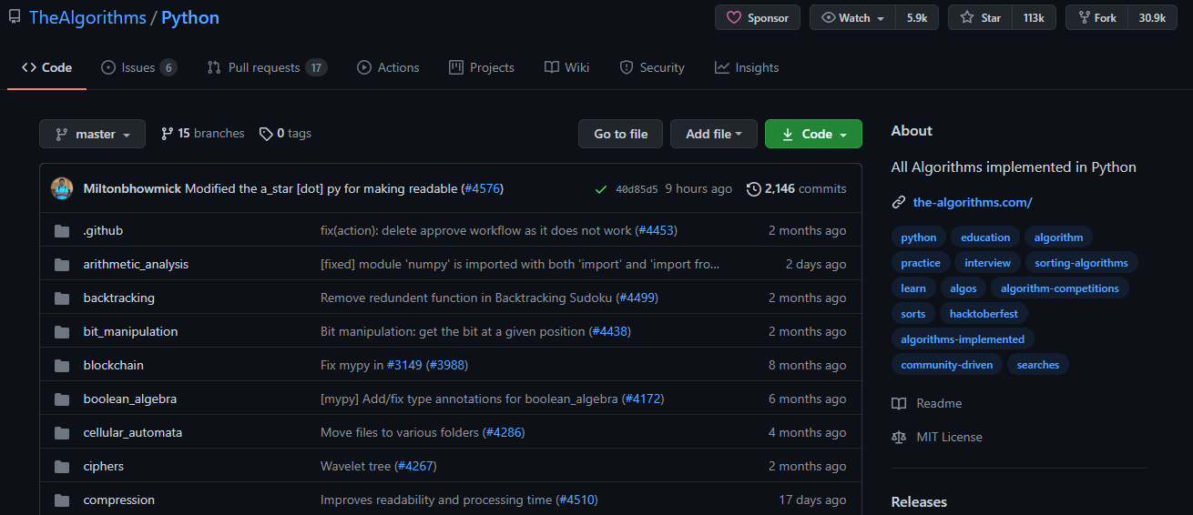
https://github.com/TheAlgorithms/Python

Slide 8
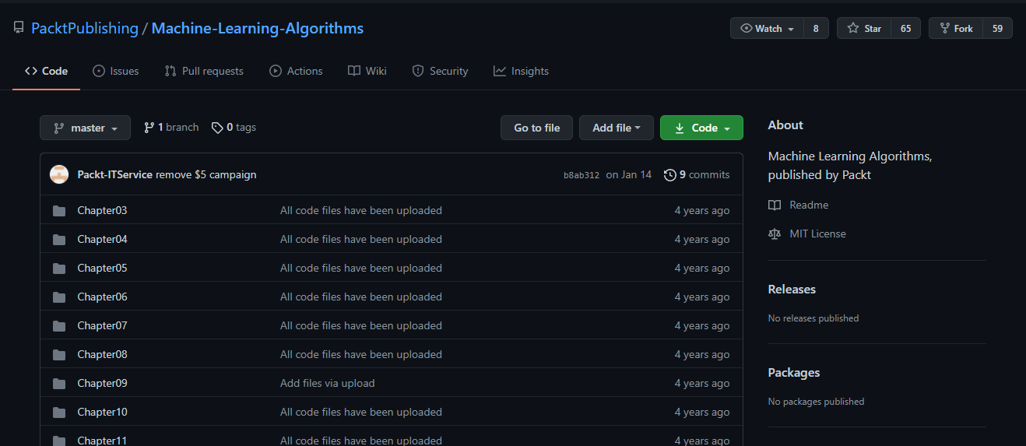
https://github.com/PacktPublishing/Machine-Learning-Algorithms

Slide 9

Enciclopédia – awesome ***
Exemplo – Sample ***
Template de projeto - *** starter
Tutorial – tutorial ***

Slide 10
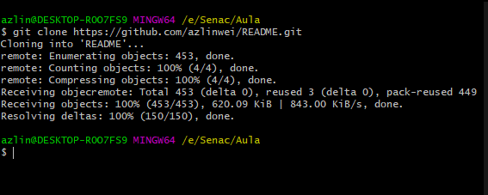
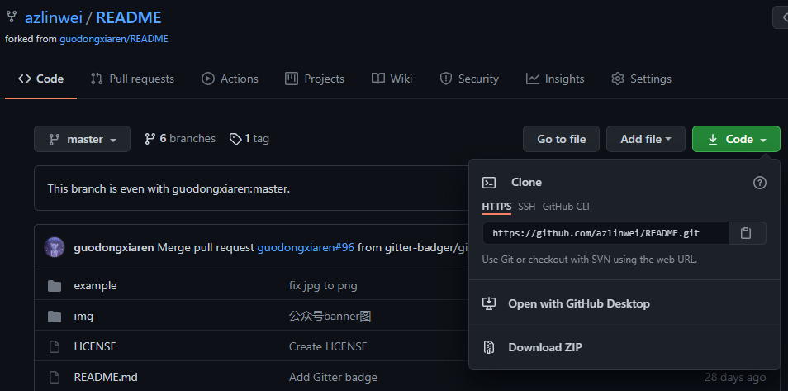
Comando: git clone ***
Enciclopédia – awesome ***
Exemplo – Sample ***
Template de projeto - *** starter
Tutorial – tutorial ***

Slide 11


Comando: git init + git remote add origin + Endereço
Comando: git status

Slide 12
Working directory
Staging area
Repository
Comando: git config –global user.name “Usuario”
git config –global user.email “Email”
Comando: git add . Ou nome de arquivo
git status
git commit –m “Primeiro Up”
git remote add origin “Link”
git branch
git push origin master
git pull origin master

Slide 13
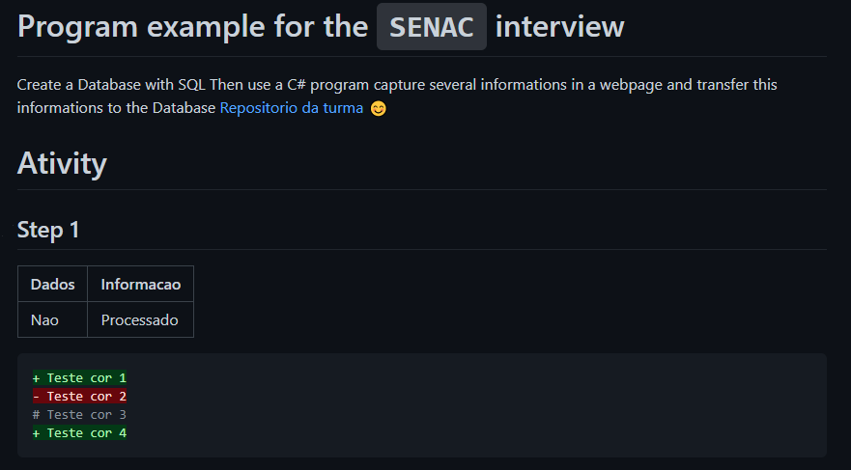
# Program example for the `SENAC` interview
Create a Database with SQL
Then use a C# program capture several informations in a webpage
and transfer this informations to the Database
[Repositorio da turma](https://github.com/azlinwei/Dev)
:blush:
# Ativity#
# Step 1
| Dados | Informacao |
| :-----| :----------|
| Nao | Processado |
```diff
+ Teste cor 1
Teste cor 2
# Teste cor 3
+ Teste cor 4
```

